Slide 1


Birth Rate Decline
Data Analytic Squaddd
Sy Tran
Billye Merritts
Catherine Hwang
Tristan Nguyen

Slide 2

Introduction

Slide 3
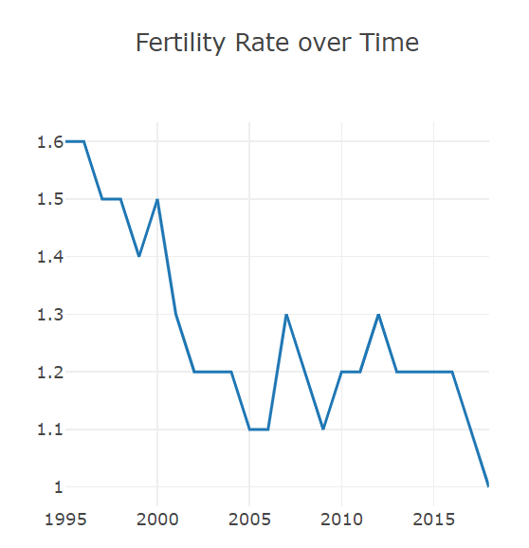
Fertility

Slide 4
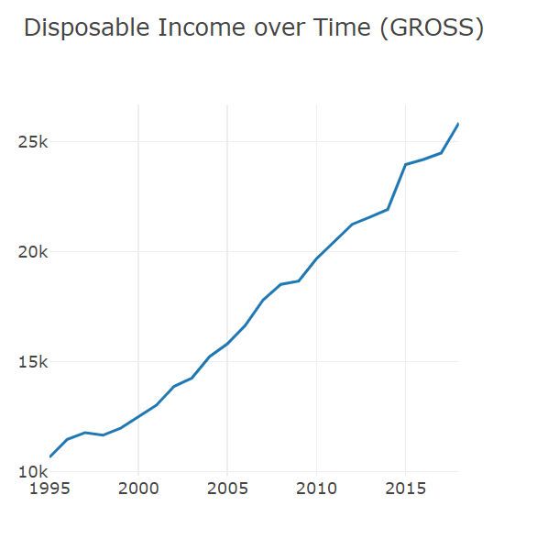
Adjusted Gross
Lower birth rates and falling working-age populations also mean that there are fewer consumers. This reduces the opportunities to generate growth on the domestic market, leaving those countries with low birth rates more exposed to external shocks

Slide 5
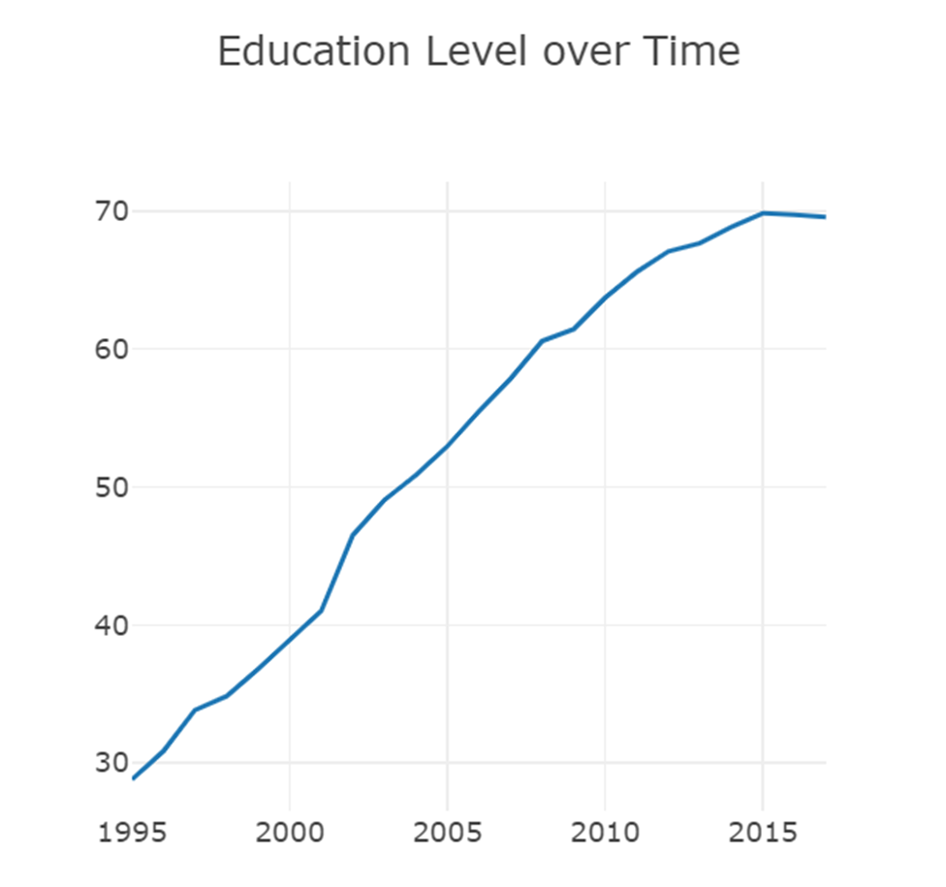
Education
These are large effects, suggesting that women with eight years of schooling would have a fertility rate 53 percentage points lower than those with no schooling at all, and are consistent with observed data. ... Female education has a greater impact on age of marriage and delayed fertility than male education

Slide 6
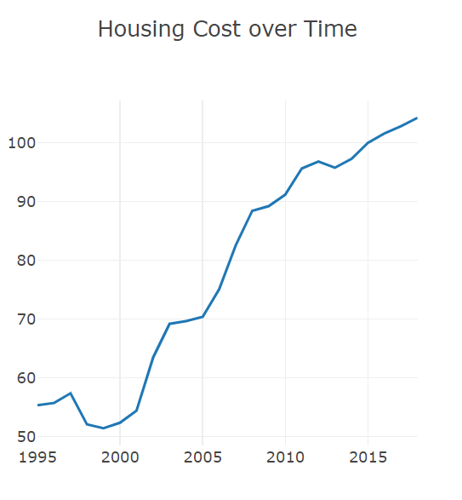
Housing Cost
Rising home values have a negative impact on birth rates because they represent, on average, the largest component of the cost of raising a child: larger than food, child care, or education

Slide 7
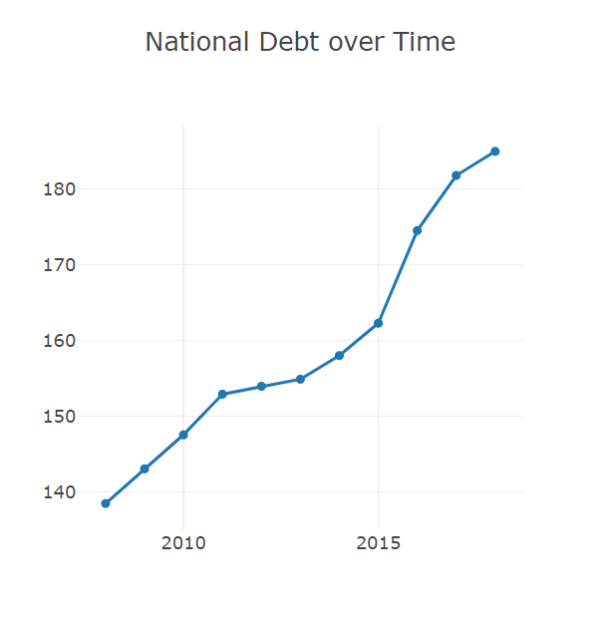
National Debt
Interestingly, we show that the higher the cost of rearing children, the less likely is that a recovery of fertility is induced by debt reduction policy. This means that the debt tightening objectives being currently pursued by several developed countries can go hand in hand with the recovery of fertility provided that the child bearing costs are sufficiently low or reduced accordingly.

Slide 8
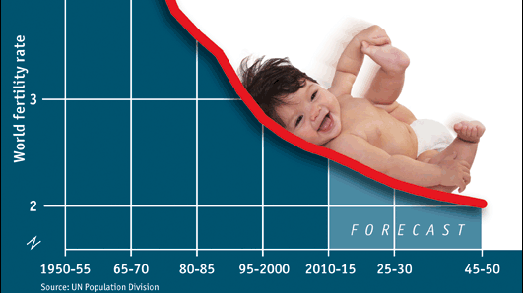
Conclusion and Solutions

Slide 9
References
Why Low Birth Rate is Bad
https://www.bbc.com/news/health-53409521
Being Replaced for Maternal Leave
https://hbr.org/2020/11/maternity-leave-isnt-enough-to-retain-new-moms
Housing cost- [Housing Speculation and Housing Price Bubble in Korea]
(https://www.researchgate.net/publication/228180344_Housing_Speculation_and_Housing_Price_Bubble_in_Korea)
Avg hours worked
[Employment - Hours worked - OECD Data]
(https://data.oecd.org/emp/hours-worked.htm)
South Korea national debt 2008- [How South Korea Weathered the 2008 Financial Crisis > Articles (https://www.globalasia.org/v8no1/feature/how-south-korea-weathered-the-2008-financial-crisis_shalendra-d-sharma)
Robots helping Japan’s Olympic games-
https://tokyo2020.org/en/news/new-robots-unveiled-for-tokyo-2020-games
Low birth rate of South Korea- https://www.reuters.com/article/us-southkorea-fertility-rate/south-koreas-fertility-rate-falls-to-lowest-in-the-world-idUSKBN2AO0UH
Why low birth rate is bad-
https://www.bbc.com/news/health-53409521

